Slide 1
A Serverless Discord Bot
A side project by Chatz

Slide 2

The Challenge
New World is a fantasy MMO
My company/clan are mercenaries for hire
We run 50 player raids called Invasions on behalf of other companies
Stats are collected manually to pay members monthly, no API
We communicate on Discord
Could I automate this with a Discord bot?

Slide 3
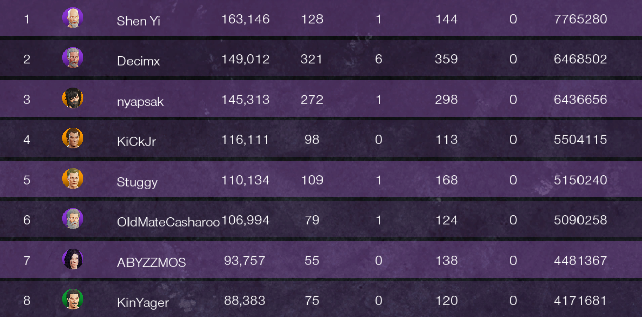
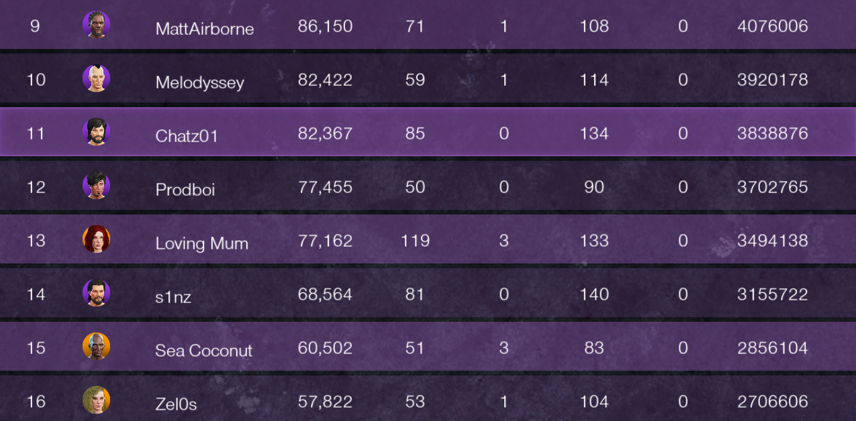

Goals
Generate monthly report
Track stats for company members
Easy for anyone in the company to use
Build and iterate quickly
Cost as little as possible to run
Learn some new things along the way
x7 images per invasion, ~6 invasions per week

Slide 4
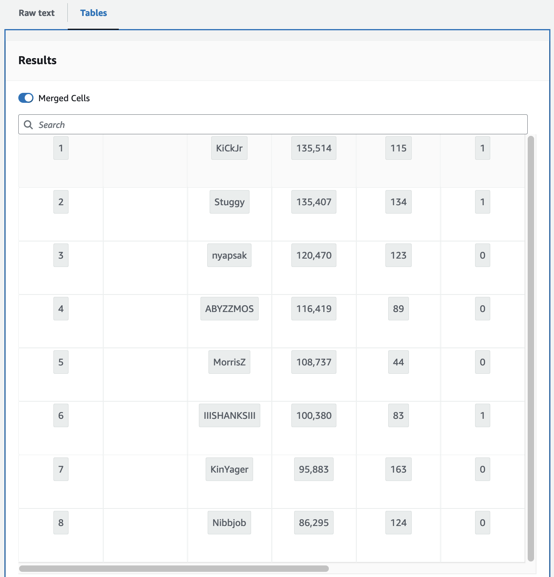
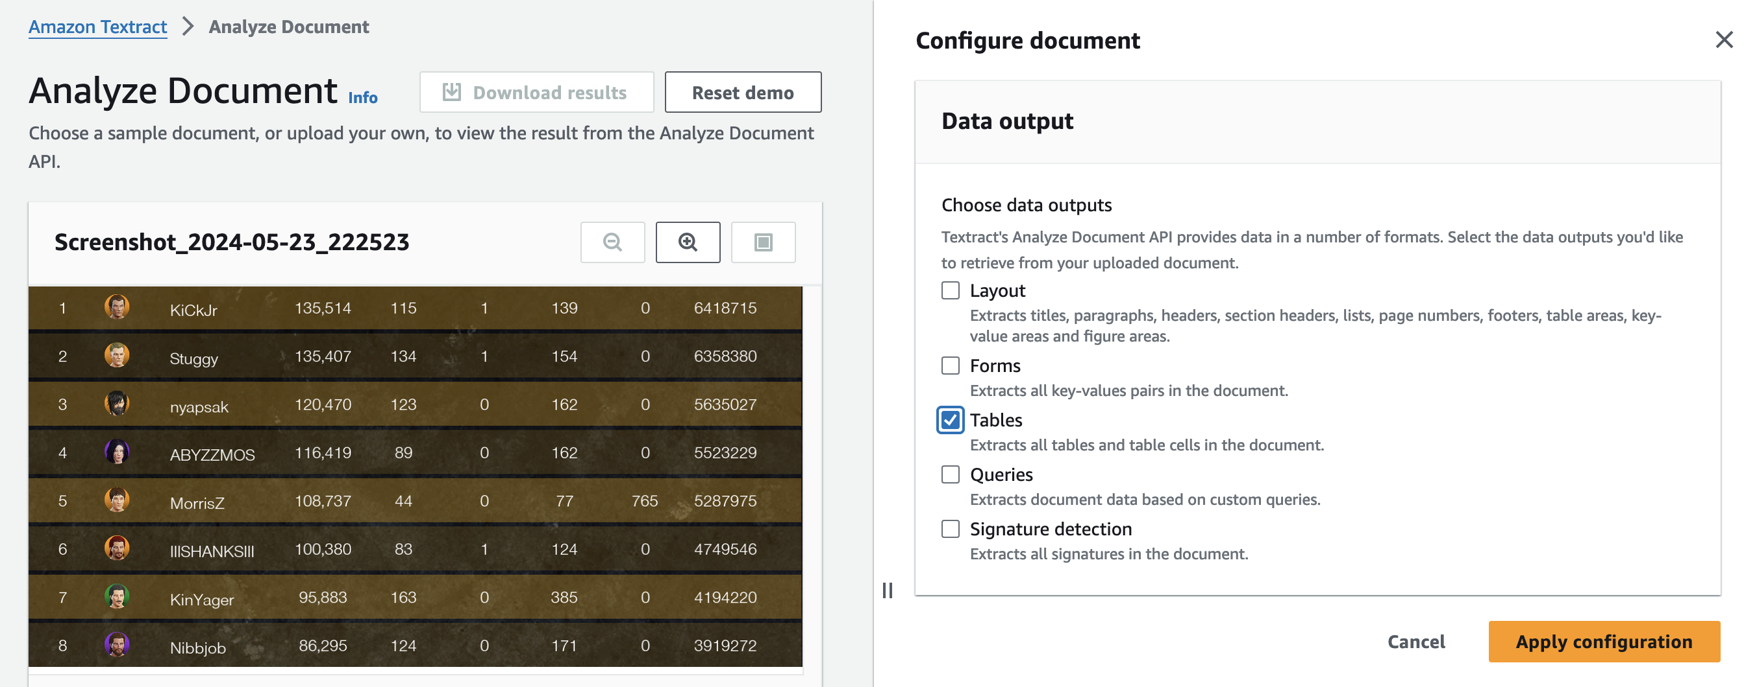
Amazon Textract

Slide 5

Iteration #1- Scan Screen Shots
Drop screen shots into S3
S3 event notification calls Lambda
Textract provides sample code for extracting tables
Dump results into DynamoDB table
Build and deploy with AWS SAM
AWS SAM

Slide 6
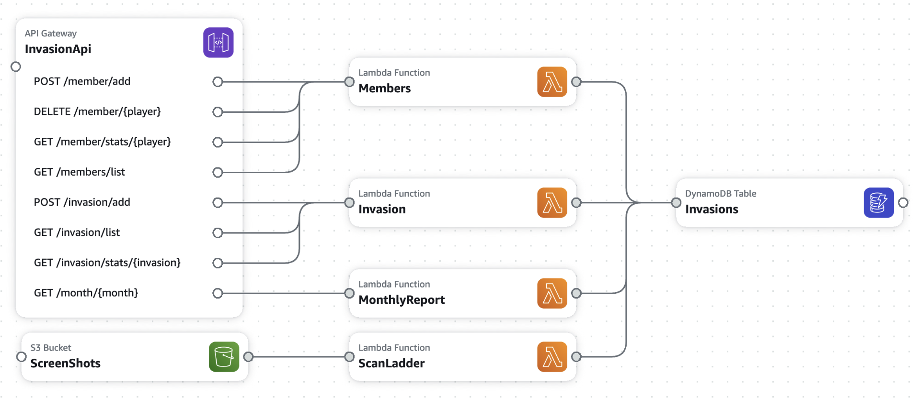
Iteration #2 – APIs to Functionality
Lambdas for
Members
Invasion report
Monthly report
Simple REST APIs

Slide 7
DynamoDB Single Table Keys
Primary Key | Secondary Key
#member | {player}
#invasion | {invasion}
#ladder#{invasion} | {rank}
#month#{month} | {player}
On Demand to minimize costs
Eventual consistency and last writer wins fits problem domain
Generate reports easily from console until implemented
Able to avoid scans, optimize queries with index(es) later once matured

Slide 8
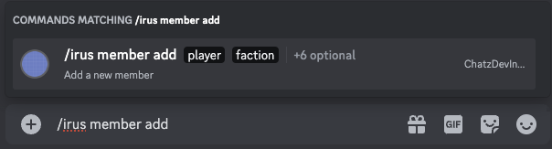
Discord Bot
- name: irus
description: Manager company members and invasions
options:
- name: member
description: Manage company members
type: 2
options:
- name: list
description: List current members
type: 1
- name: add
description: Add a new member
type: 1
options:
- name: player
description: Player name in New World
type: 3
required: true
- name: faction
description: Faction of the new member
type: 3
required: true
choices:
- name: "Green"
value: "green"
Primarily used for chat and streaming
Bots are common for most games to track players, skills, equipment and stats
Start by creating bot in Discord developer console
Post and update command structure

Slide 9
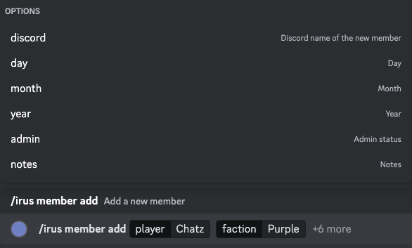
Discord Bot
{
"guild_id": ”1234567890123456",
"id": ”1234567890123456",
"name": "irus",
"options": [ {
"name": "member",
"options": [
{
"name": "add",
"options": [
{
"name": "player",
"type": 3,
"value": "Chatz"
},
{
"name": "faction",
"type": 3,
"value": "purple"
}
],
"type": 1
}
],
"type": 2
} ],
"type": 1
}
Command parameters can be required or optional
Post from Discord includes json structure based on command definition

Slide 10

Virtual Hosting
Serverless
Most bots are hosted on virtual servers that are running 24x7
Paying* for a server regardless of bot usage
Linux host to manually configure, update and scale
Only execute/pay* when a discord command is run
No ongoing infrastructure maintenance required
Automatically scale as needed
*For a single bot, both options should run within AWS free tier

Slide 11
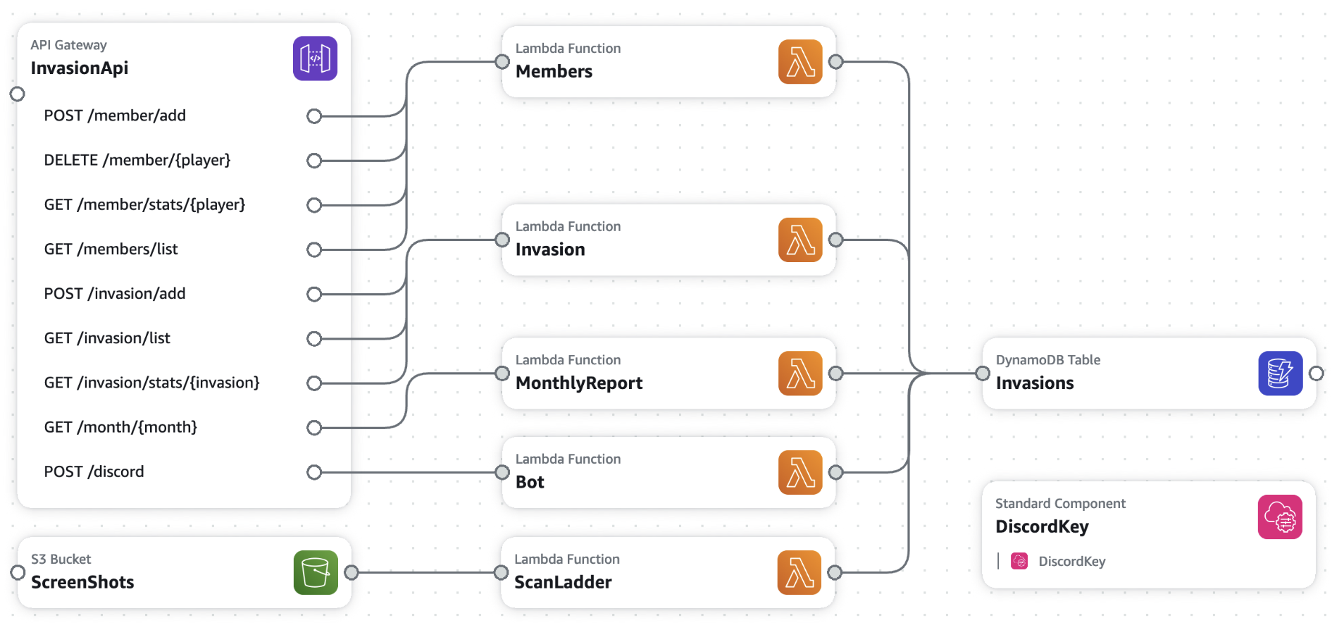
Iteration #3 - Lambda Bot
Authentication using keys in SSM
Manage optional parameters
Route commands
Member & report code duplicated in Bot lambda
Download files from Discord into S3 for scanning
Respond as Discord expects

Slide 12
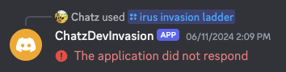
All done right?
So why is Discord reporting some some commands are failing…
1
2
3
Discord expects a response within 3 seconds

Slide 13
All done right?
Sync vs Async
So why is Discord reporting some some commands are failing…
I had assumed a synchronous interaction with Discord
Downloading, scanning and processing one image may take longer than 3 seconds
Discord supports asynchronous responses using webhooks
1
2
3
Discord expects a response within 3 seconds

Slide 14
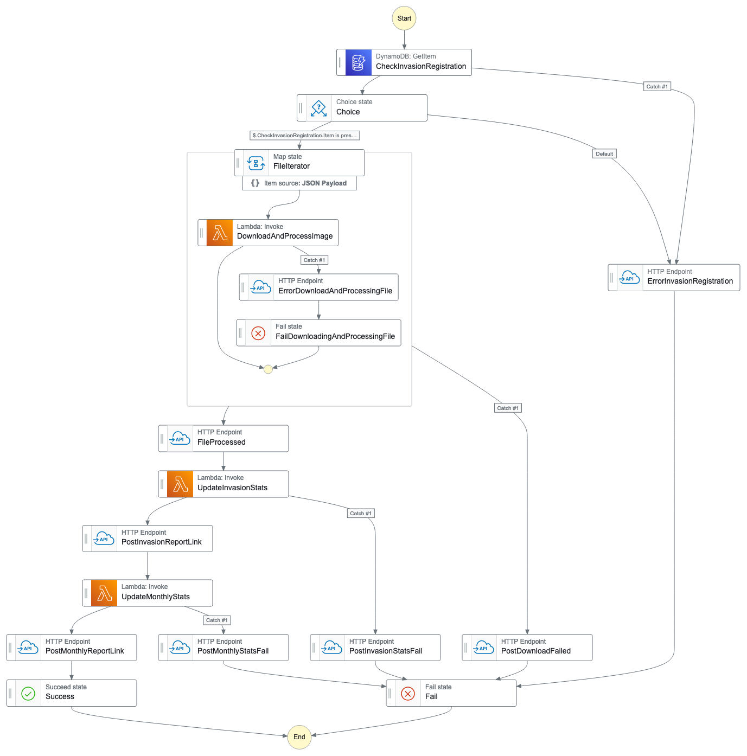
Orchestration
Download and process 7 images concurrently
Retry any that fail to download
Once all 7 are downloaded generate invasion and monthly stats
Post progress updates links to CSV reports to Discord
Post errors to Discord for failures

Slide 15
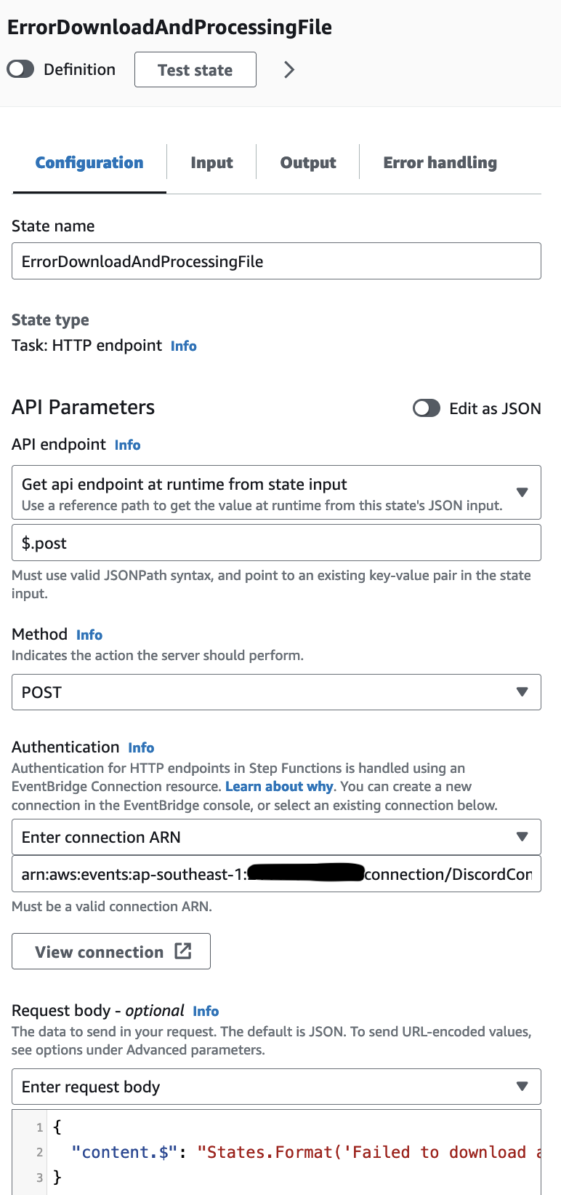
HTTP Endpoint
Step Functions can call any HTTP endpoint via EventBridge
EventBridge expects endpoint to require authentication
Default Discord webhook includes unique token
DiscordConnection:
Type: AWS::Events::Connection
Properties:
Description: Connection to send async responses to Discord
AuthorizationType: API_KEY
AuthParameters:
ApiKeyAuthParameters:
ApiKeyName: foo
ApiKeyValue: bah

Slide 16
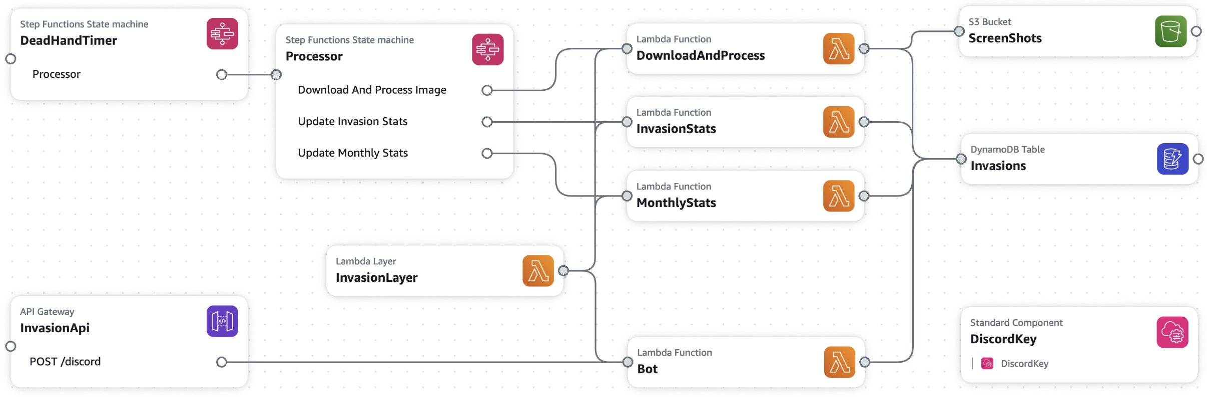
Iterations #4 – Step Functions & Layer

Slide 17
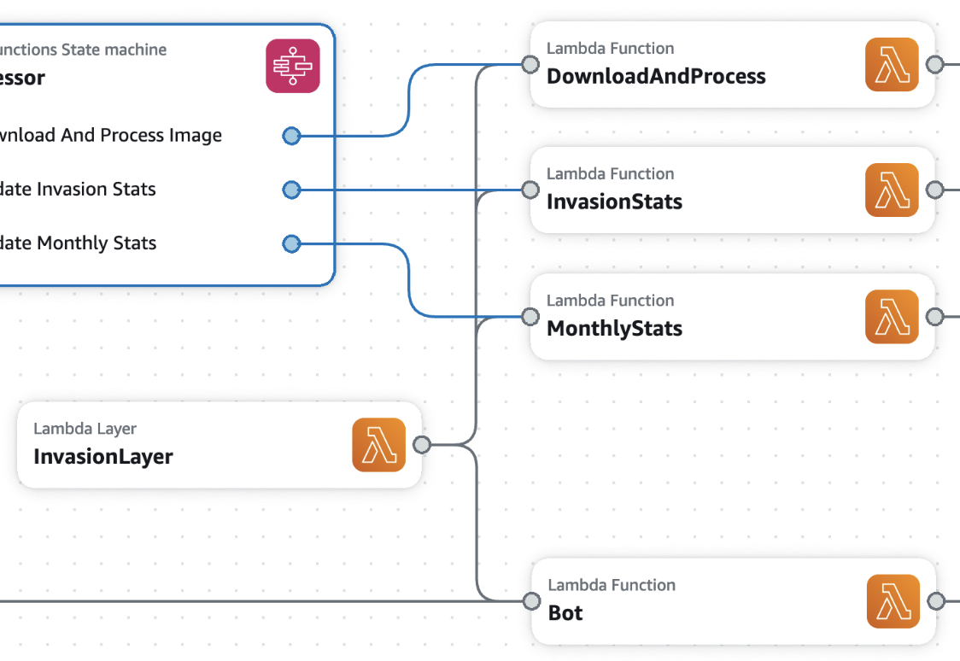
Lambda Layer
Layer encapsulates all the business logic, including all boto3 interactions
Shift from functions to classes now domain is understood
Significantly simplifies business logic testing with pytest
Interpretation of Discord commands solely within Bot lambda

Slide 18
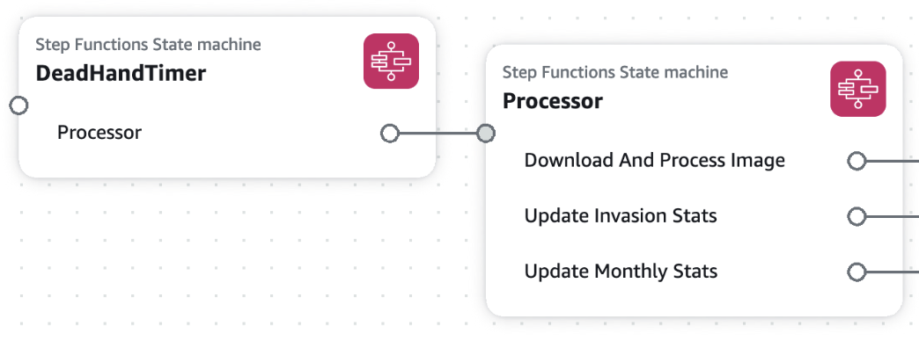
Step Functions
Utilised step function error handling to catch lambda function failures
New testing features make it easier to test individual steps
The maximum time a Discord will allow an asynchronous response is 15 minutes
Use another Step Function as a dead hand timer in case Processor is taking too long

Slide 19
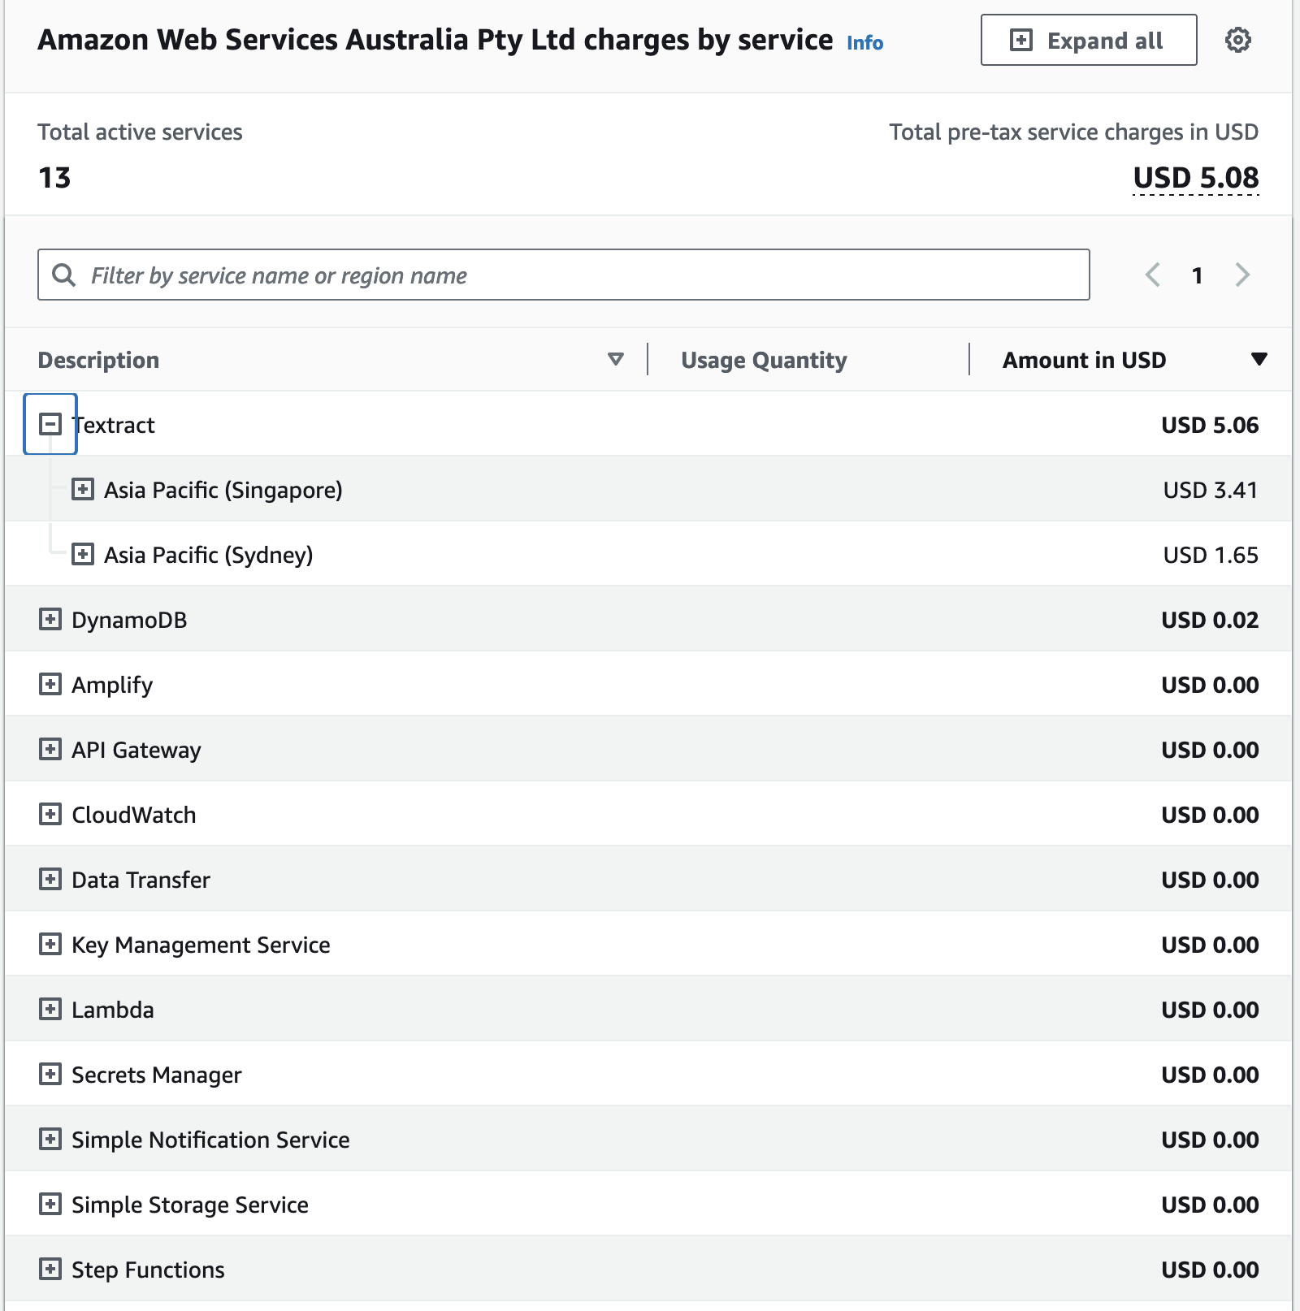
Costs
Textract is the most expensive component
Free tier is 100 table scans per month, for 3 months, then $0.015 per scan
Test deployment is in Singapore, hence the higher costs in that region
Expecting AUD$3/month in Sydney

Slide 20

Goals
Accuracy is better than manual process
I learnt about Discord bots, Python classes and testing, Step Function HTTP Endpoints and Textract
Serverless is a good choice for Discord bots, especially if using cloud services

Slide 21

Next Steps
Improving testing and messages to users
Add local secondary index to replace most queries with getItem calls
Utilise Discord’s user mgmt to avoid manual add/remove
Explore options to reduce Textract costs

Slide 22



Thank You
david.chatterton@gmail.com
chatz

